Slide 1
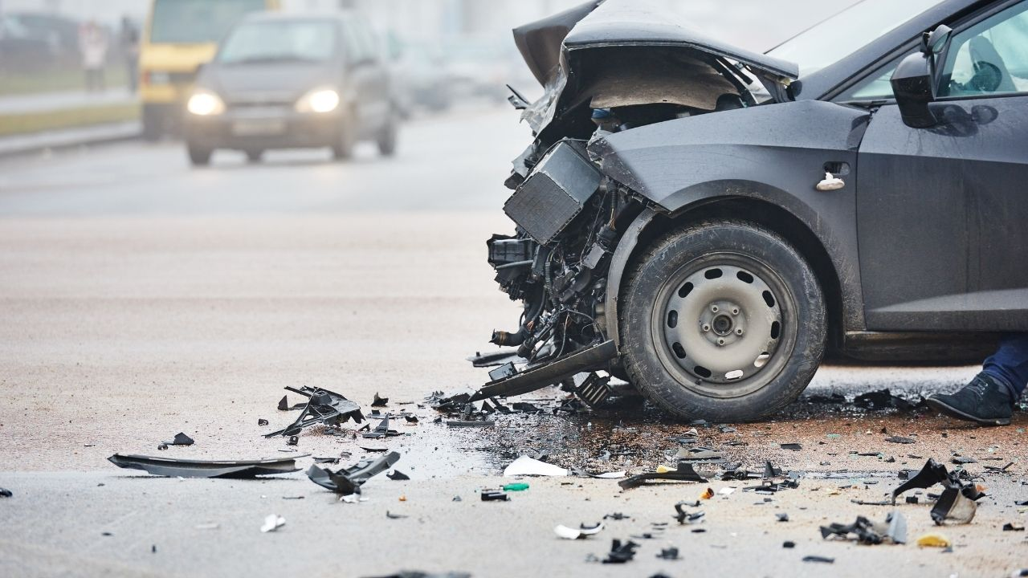
Exploratory Data Analysis on Understanding Road Accidents
Key Weather Patterns & Safety Insights

Slide 2
Meet the Project Team
Kalliopi Giannoukou
Evangelia Katsanou
Athanasios Sakatziadis

Slide 3
Project Scope
Problem Statement:
Road accidents cause high costs, delays, and serious injuries. We want to understand what drives severe accidents and how to prevent them.
Business Impact:
Higher accident rates → higher premiums ,claim costs & loss ratios
Increased liability risk
Project Goal:
Understand how weather and conditions affect road accidents
Identify top states with the highest accident rates.
Recommend safety measures to reduce risk and costs.
Reduce costs, insurance premiums, and support awareness campaigns.

Slide 4
About the Dataset
We used a nationwide U.S. Car Accident dataset from Kaggle which contains 7.7 million accident records from 49 U.S. states.
Data was collected in real time (2017-2022) from multiple sources such as:
Traffic sensors
Traffic cameras
State & national transportation departments
Law enforcement reports
And it includes key information such as:
Location, time, weather, road conditions, and accident severity
ID | Severity | Start_Time | State | City | County | Visibility(mi) | Wind_Speed(mph) | Weather_Condition | Sunrise_Sunset | Traffic_Signal | Year
A-9207 | 3 | 1/1/2017 0:17 | CA | El Cerrito | Contra Costa | 10.0 | 5.8 | Partly Cloudy | Night | TRUE | 2017
A-9208 | 3 | 1/1/2017 0:26 | CA | Berkeley | Alameda | 10.0 | 11.5 | Overcast | Night | FALSE | 2017
A-9209 | 2 | 1/1/2017 0:53 | CA | Oakley | Contra Costa | 10.0 | 5.8 | Partly Cloudy | Night | FALSE | 2017
A-9210 | 3 | 1/1/2017 1:18 | CA | Richmond | Contra Costa | 9.0 | 3.5 | Mostly Cloudy | Night | FALSE | 2017
A-9211 | 3 | 1/1/2017 1:20 | CA | El Cerrito | Contra Costa | 9.0 | 3.5 | Mostly Cloudy | Night | TRUE | 2017

Slide 5






Tools Overview
Python — main environment for analysis
Pandas — for cleaning and exploring the data
Matplotlib / Seaborn — for simple, clear visualizations
Jupyter Notebook — to organize analysis and generate graphs
GitHub — Version control and collaboration

Slide 6
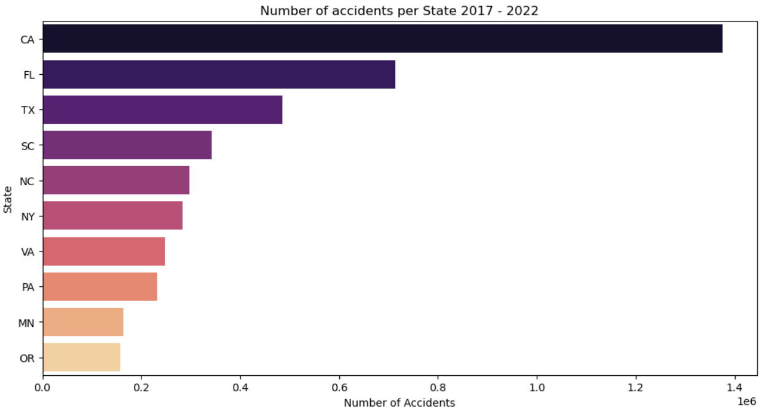
Top 10 States with largest number of accidents

Slide 7
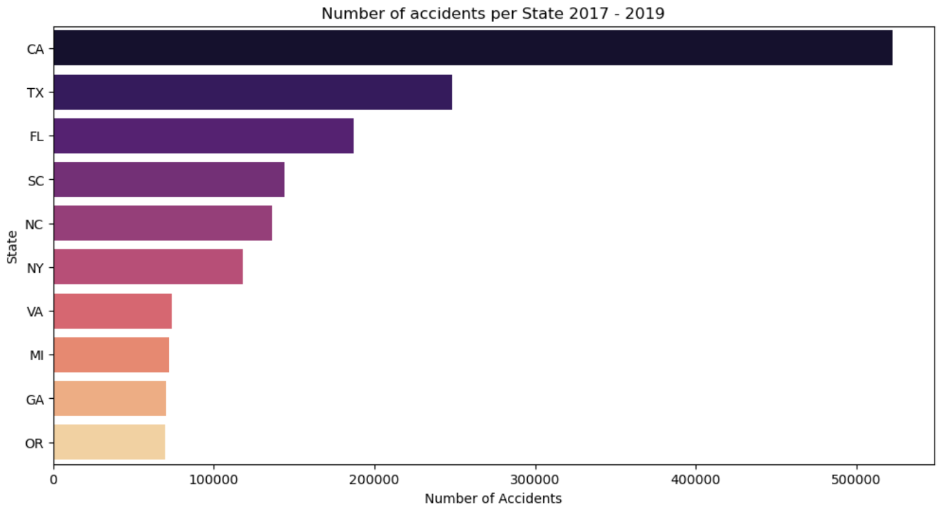
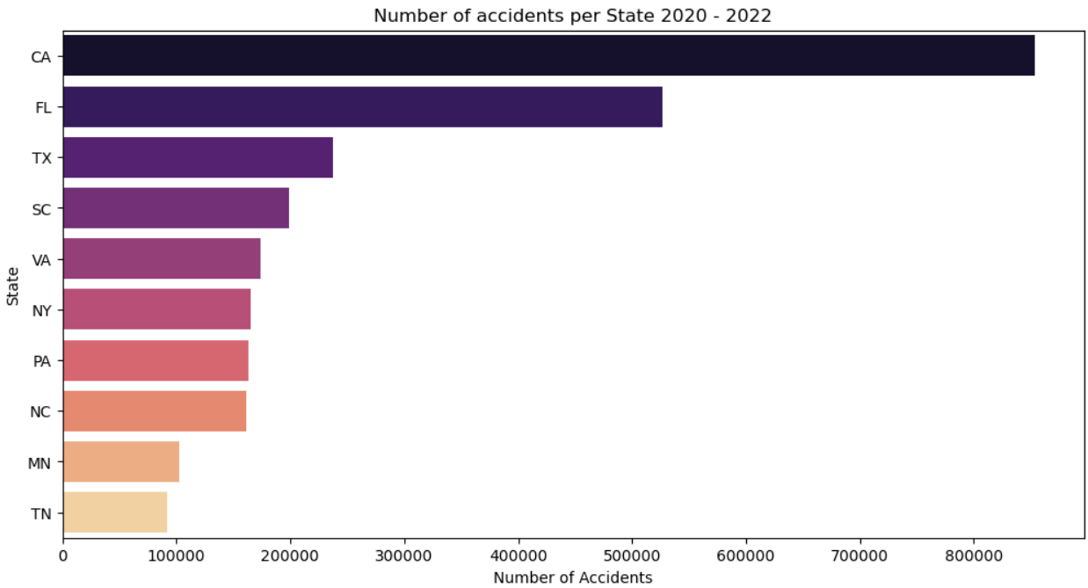
Comparison 2017-2019 & 2020-2022

Slide 8
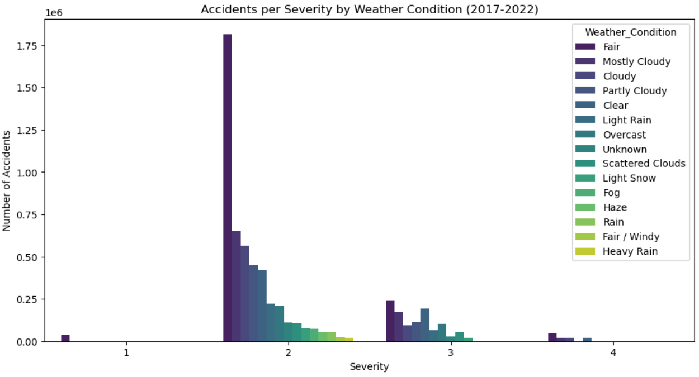

Slide 9
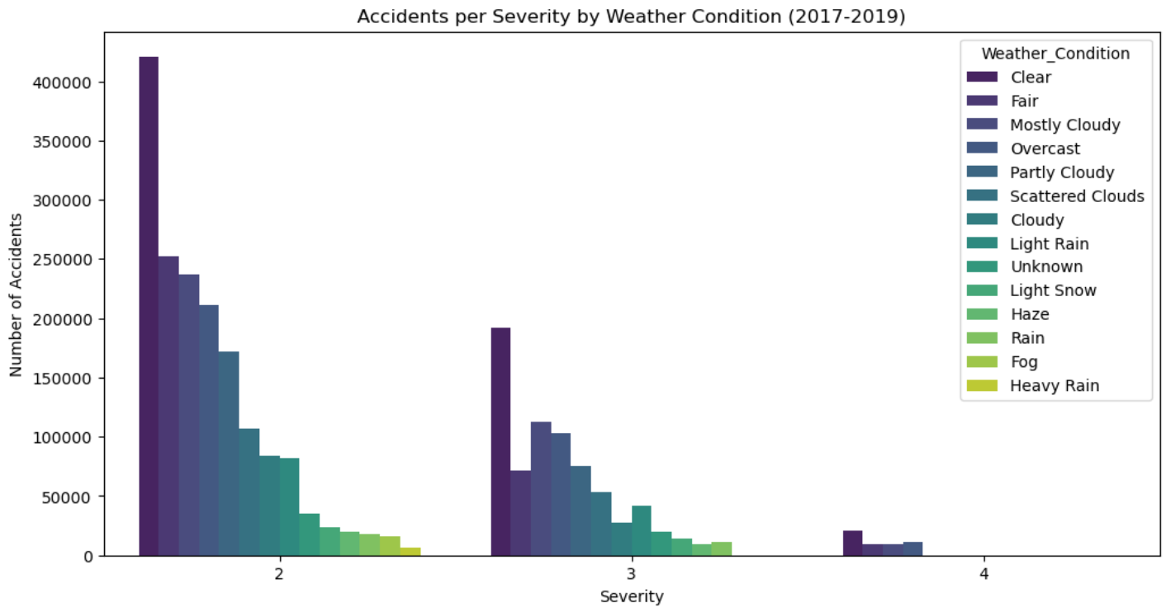
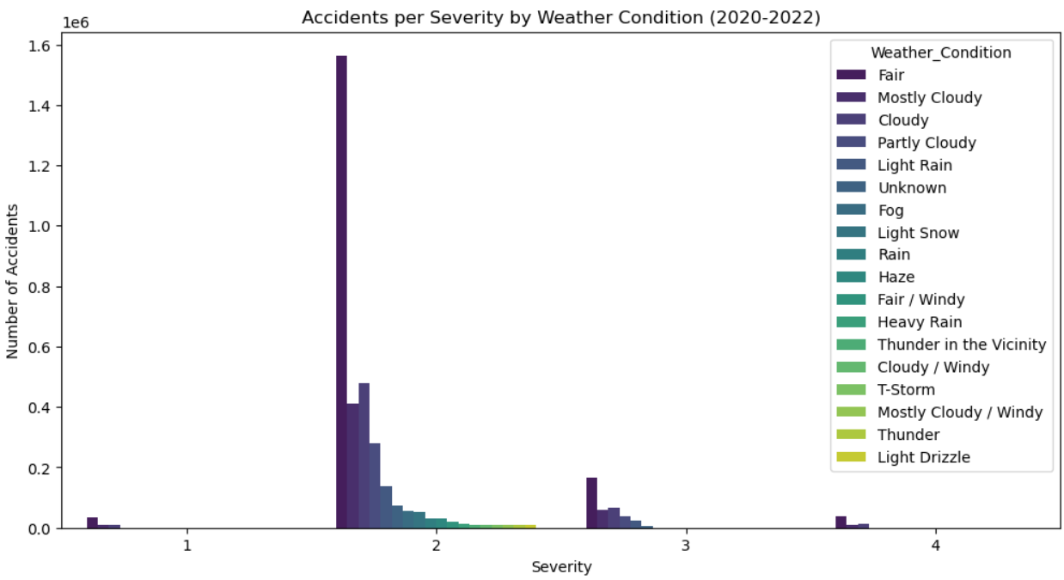
Comparison of severity by Weather Condition between periods 2017-2019 & 2020-2022

Slide 10
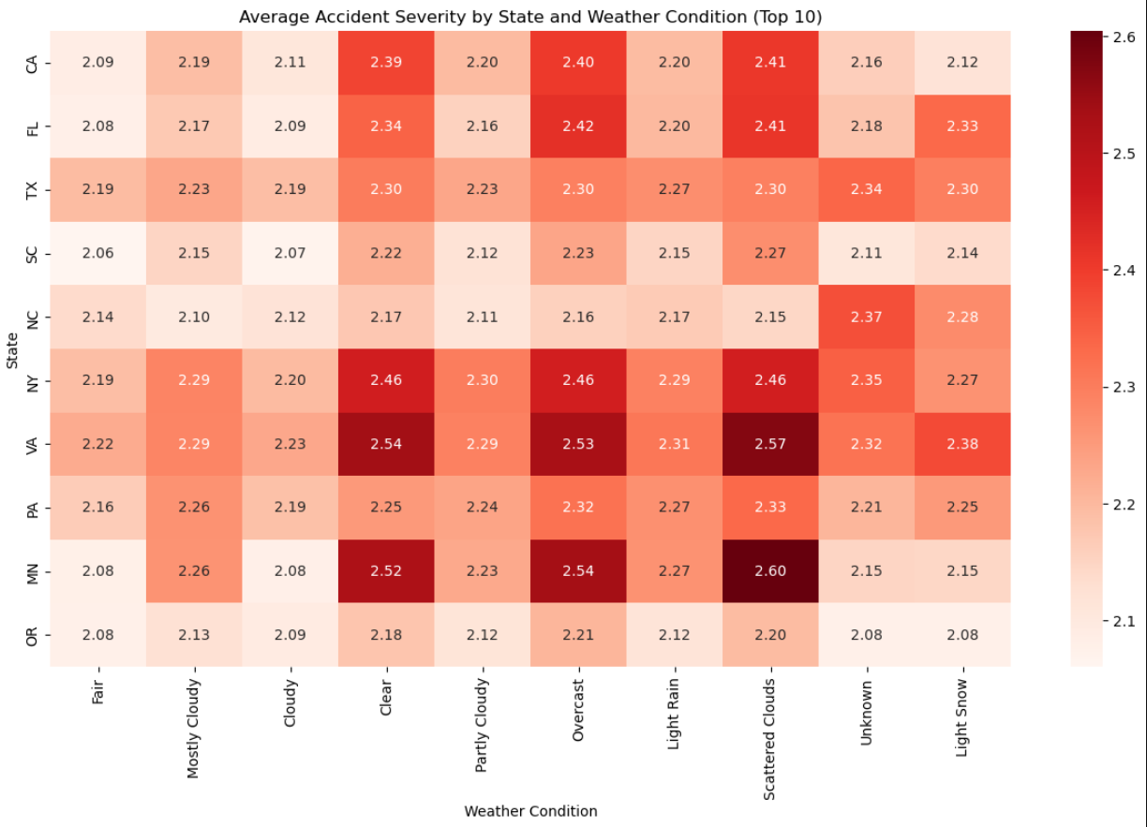
Top 10 States 2017 - 2022

Slide 11
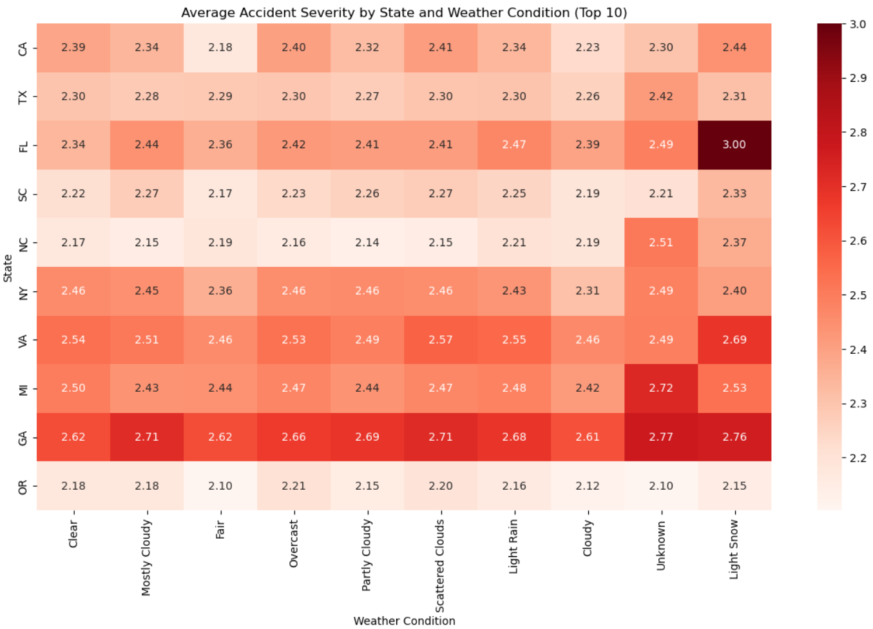
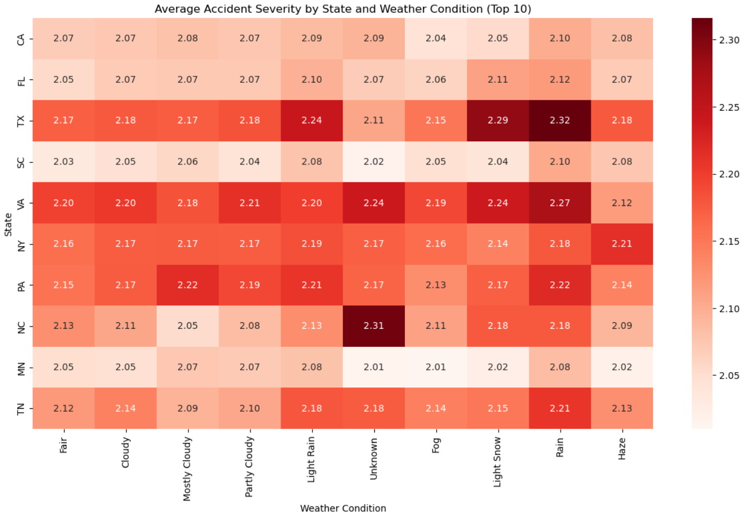
Comparison between periods 2017-2019 & 2020-2022

Slide 12

THANK YOU!

